Slide 1









Case 1. trivial relationships
form a user group
Case 2. non-trivial local relations-
hips form a user group
Type A blood
Boise
Local
golf club
Local
soccer club
Local
dancing club
Student
Cohesiveness of
Cohesiveness of

Slide 2





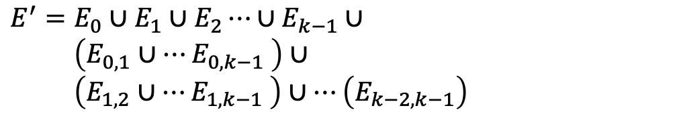



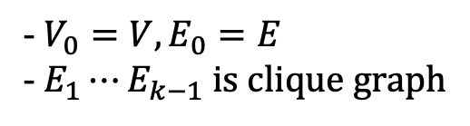




Clique graph
$$I_{flexi}=(G^{′}, τ=\frac{\log{(\left|V_{H}−k\right|)}}{\log{(|V_{H}|}})$$
Self-removed Bipartite edges
- $V_{0}=V, E_{0}=E$
- $E_{1}⋯E_{k−1}$ is clique graph
$$G^{′}$$
$$G_{2}$$
$$…$$
$$G_{1}$$
$$G$$
$$V^{′}=V_{0}∪V_{1}∪V_{2}⋯∪V_{k−1}$$
$$…$$
$$G_{0}$$
$$E^{′}=E_{0}∪E_{1}∪E_{2}⋯∪E_{k−1}∪$$
$\left(E_{0, 1}∪⋯E_{0, k−1} \right)∪$
$\left(E_{1, 2}∪⋯E_{1, k−1} \right)∪⋯\left(E_{k−2, k−1}\right)$
$$I_{kc}=(G, k)$$
$$…$$
$$G_{k−1}$$

Slide 3



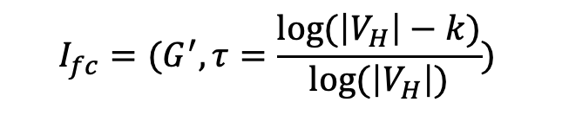

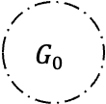







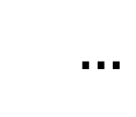




$$I_{fc}=(G^{′}, τ=\frac{\log{(\left|V_{H}\right|−k)}}{\log{(\left|V_{H}\right|)}})$$
Clique graph
Self-removed Bipartite edges
$$G^{′}$$
$$G_{2}$$
$$G_{2}$$
$$…$$
$$…$$
$$G_{1}$$
$$G_{1}$$
$$G=G_{0}$$
$$G$$
$$…$$
$$…$$
$$G_{0}$$
$$…$$
$$G_{k−1}$$
$$…$$
$$I_{kc}=(G, k)$$
$$G_{k−1}$$

Slide 4
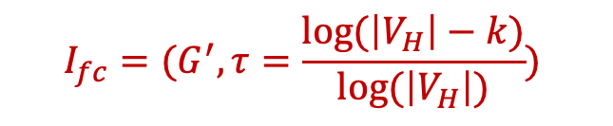

$$I_{fc}=(G^{′}, τ=\frac{\log{(\left|V_{H}\right|−k)}}{\log{(\left|V_{H}\right|)}})$$
Clique graph
Self-removed Bipartite edges
$$G^{′}$$
$$G_{2}$$
$$G_{2}$$
$$…$$
$$…$$
$$G_{1}$$
$$G_{1}$$
$$G=G_{0}$$
$$G$$
$$…$$
$$…$$
$$G_{0}$$
$$…$$
$$G_{k−1}$$
$$…$$
$$I_{kc}=(G, k)$$
$$G_{k−1}$$

